Slide 1


Electrical Solutions for Single- and Multi-Family Housing

Slide 2

Key Concerns for Residential Structures
Sustainability and energy efficiency
Total project cost reduction
Safety for occupants as well as installers

Slide 3
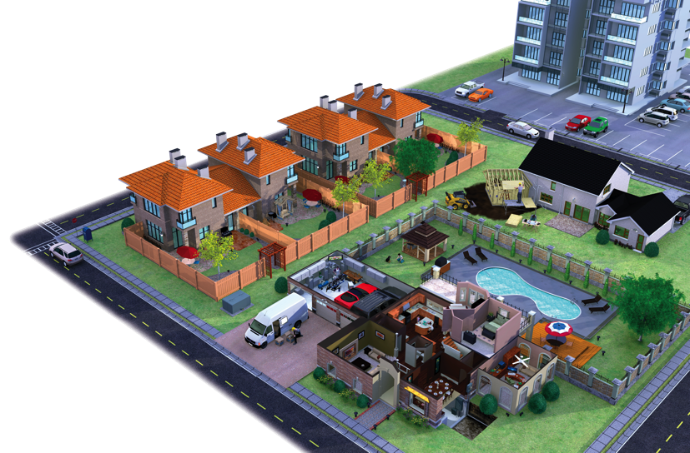
T&B Engineered
Solutions for Every
Residential Project
Single-Family Homes
Multi-Family Homes, including Apartment Complexes and High-Rise Condominiums
New Construction
Renovations and Remodeling
Additions to Existing Structures

Slide 4







Electrical System Issues for Single- and Multi-Family Housing
Continuous Operation & Sustainability
Total Project Cost Reduction
Grounding & Bonding
Safety
Power Quality, Efficiency & Reliability
Extreme Temperature Protection
Liquid Ingress Protection

Slide 5
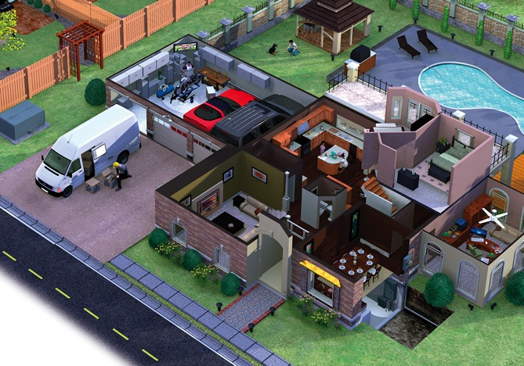

Continuous Operation & Sustainability

Slide 6

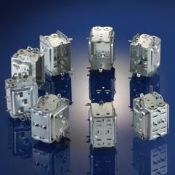
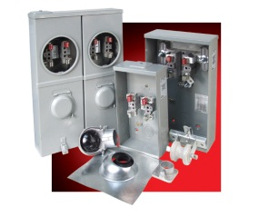
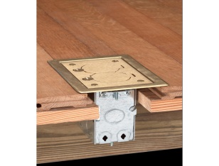
Continuous Operation & Sustainability
Thomas & Betts brands
for continuous operation
& sustainability
Technology and regulatory evolution are driving change throughout single- and multi-family homes.
Thomas & Betts focuses on providing innovative electrical solutions that are not only highly durable and maintain integrity over time, but are also flexible enough to efficiently accommodate future demands.
Blackburn®
Carlon®
Iberville®
Marrette®
Microlectric®
NuTek®
Red•Dot®
Steel City®
Iberville®
LHTQ Boxes
Microlectric®
Meter Sockets
Steel City®
Residential Floor Boxes

Slide 7
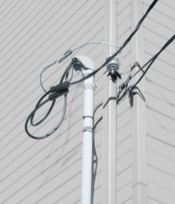
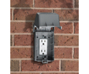

Continuous Operation & Sustainability
Thomas & Betts brands
for continuous operation
& sustainability
In the single and multi-family housing industry, one single point of failure can lead to costly rework and major profit losses.
Blackburn®
Carlon®
Iberville®
Marrette®
Microlectric®
NuTek®
Red•Dot®
Steel City®
Blackburn® /Carlon® /Microlectric®
Overhead Service entrance Connectors
Red•Dot®
Code KeeperTM Weatherproof
While-in-Use Covers
Carlon®
Media Boxes

Slide 8
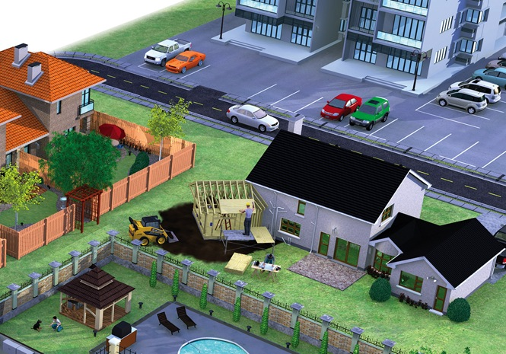

Total Project Cost Reduction

Slide 9
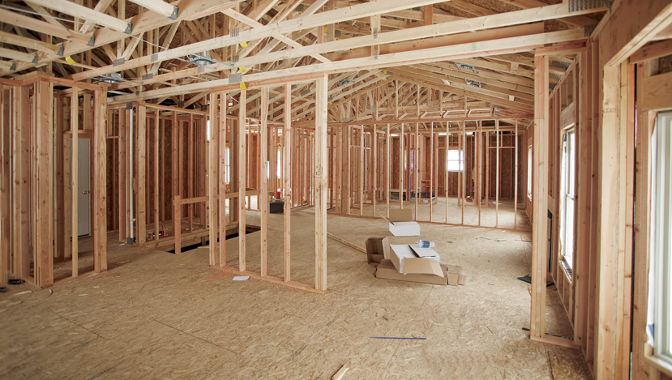

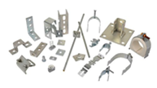

Total Project Cost Reduction
Thomas & Betts brands
for total project cost reduction
The residential market encompasses much more than the single-family home. Apartment complexes and
high-rise condos have different needs than a
2,000-square-foot house. Large, repetitive areas, firewalls and steel stud construction are differences that lead to unique needs. Labor becomes more significant, so improving efficiency plays a central role in lowering total project costs.
Blackburn®
Carlon®
Iberville®
Marrette®
Microlectric®
NuTek®
Steel City®
Iberville®
LHTQ Boxes
Steel City®
Fire Alarm Boxes
and Accessories
Superstrut®
Modular Metal Framing
System and Accessories

Slide 10

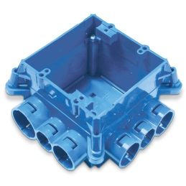
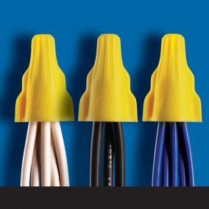
Total Project Cost Reduction
Thomas & Betts brands
for total project cost reduction
In today’s challenging economic environment, projects that were recently considered “a go” are now getting a second look and closer scrutiny.
Everyone’s goal is to improve total project economics and help make any projects viable.
Thomas & Betts can assist you in your challenge
to cut costs, without cutting corners.
Blackburn®
Carlon®
Iberville®
Marrette®
Microlectric®
NuTek®
Steel City®
Carlon®
ENT System
Marrette®
Twist-On Wire Connectors

Slide 11
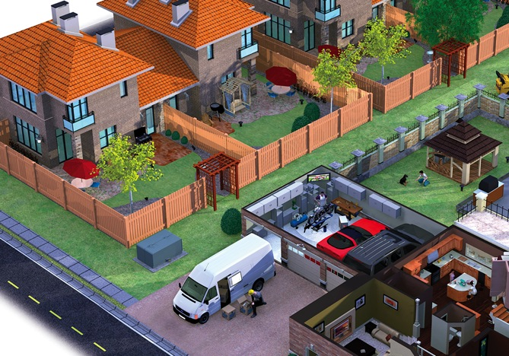

Grounding & Bonding

Slide 12
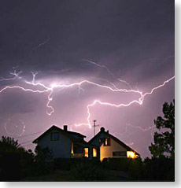
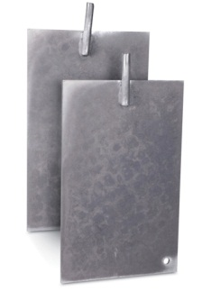
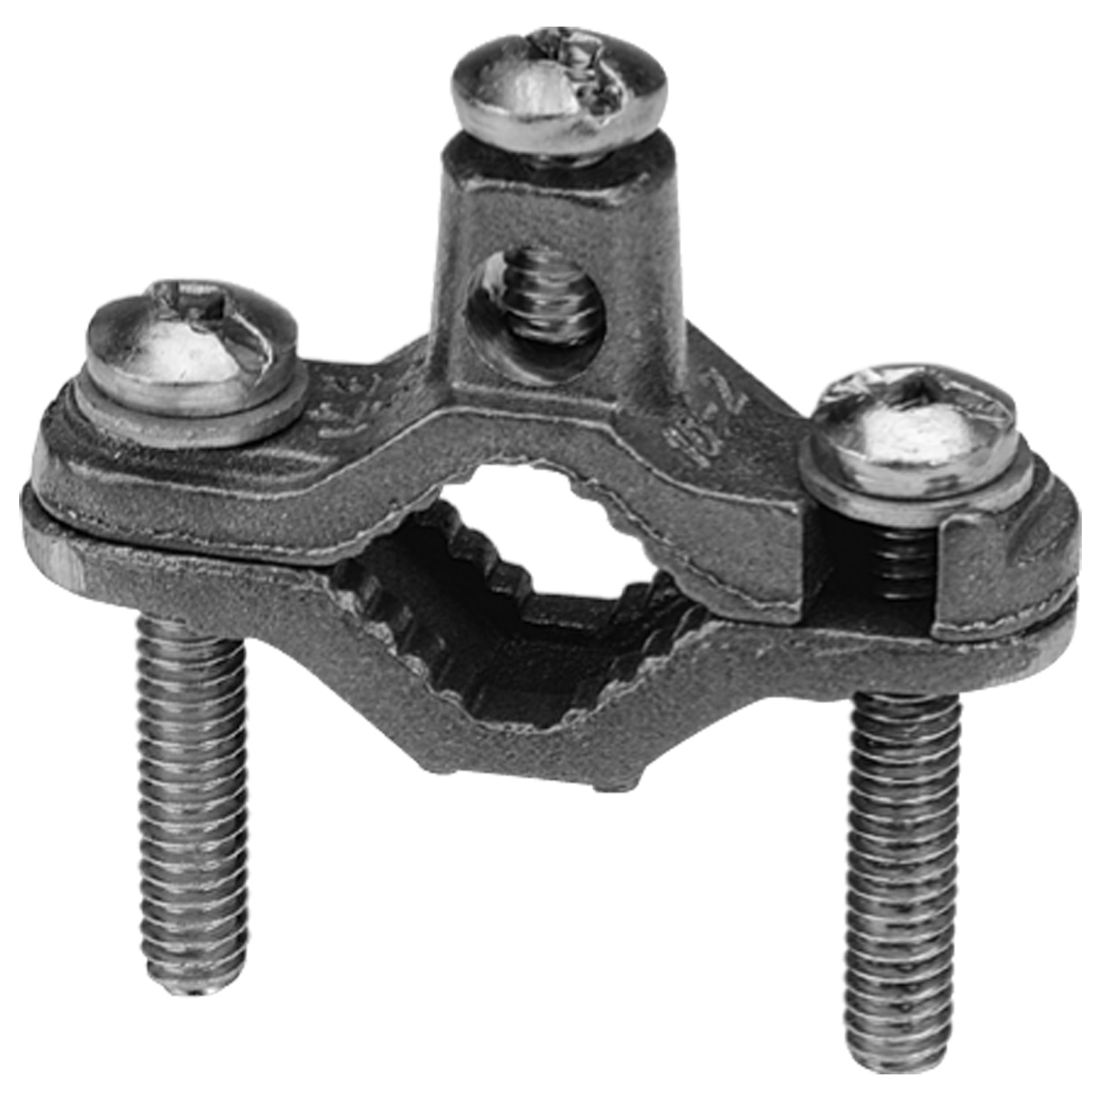
Grounding & Bonding
Thomas & Betts brands
for grounding & bonding
Thomas & Betts provides a wide range of grounding and bonding solutions to electrically connect all metallic non-current carrying items in a room or building as protection from electric shock.
Blackburn®
Iberville®
Blackburn®
Ground Plates
Iberville®
Water pipe and Ground Rod Connectors

Slide 13


Grounding & Bonding
Thomas & Betts brands
for grounding & bonding
An improperly installed or grounded electrical system can cause power failure which often leads to safety concerns.
Blackburn®
Iberville®
^{Blackburn®}
E-Z-Ground® Compression Connectors
^{Blackburn®}
Mechanical Grounding Connectors

Slide 14
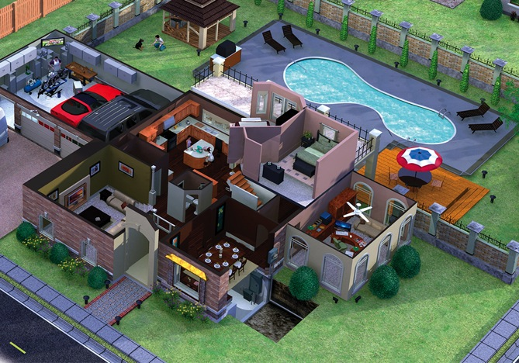

Safety

Slide 15
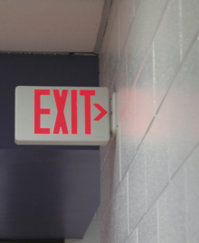


Safety
Thomas & Betts brands
for safety
Count on Thomas & Betts for emergency and exit lighting, identification products and wire management solutions for every application area in all types of residential facilities.
Carlon®
Emergi-Lite®
E-Z-CODE®
Lumacell®
Ready-Lite®
Red•Dot®
Steel City®
Emergi-Lite® /Lumacell® /Ready-Lite
Emergency Exit Lighting
E-Z-CODE®
Safety Labels, Tags,
Signs and Barricade Tapes

Slide 16
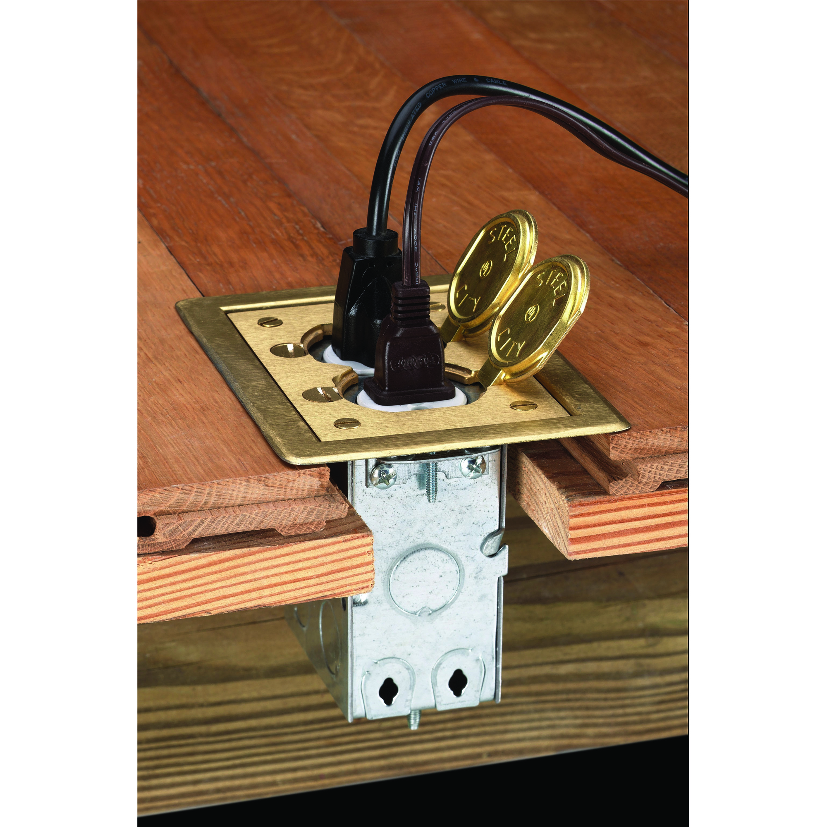
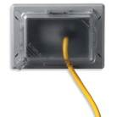
Safety
Thomas & Betts brands
for safety
No one is immune to safety concerns.
They affect workers, construction schedules and the bottom line across a broad spectrum of industries.
Carlon®
Emergi-Lite®
E-Z-CODE®
Lumacell®
Ready-Lite®
Red•Dot®
Steel City®
Steel City®
Residential Mop TiteTM Floor Boxes
Red•Dot®
Code KeeperTM Weatherproof While in Use Covers

Slide 17
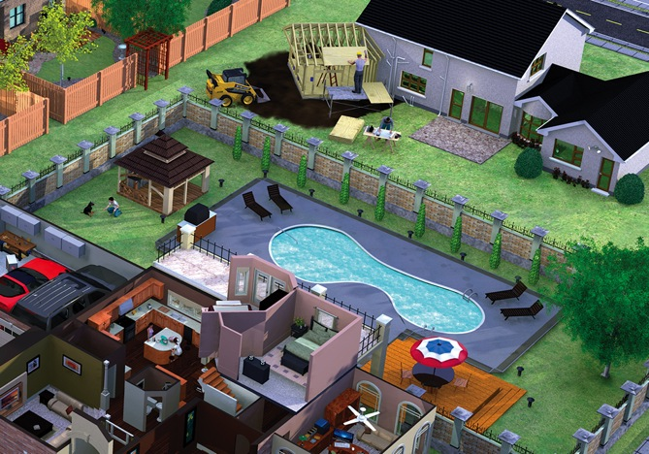

Liquid Ingress Protection

Slide 18
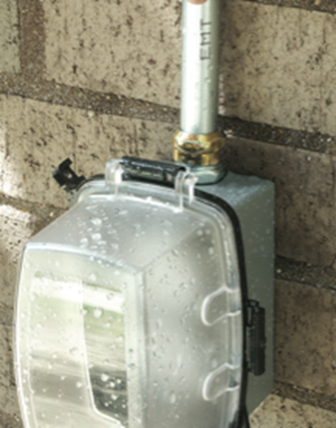

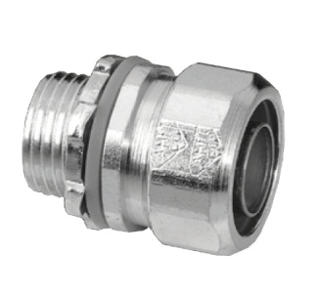
Liquid Ingress Protection
Thomas & Betts brands
for liquid ingress protection
Outdoor weatherproof protection for electrical systems is more significant than ever. Investments in solar energy, new high-efficiency air-quality units and even outdoor living upgrades require significant upgrades in power and lighting to the exterior of the home.
Carlon®
Iberville®
Red•Dot®
Reznor®
Shrink-Kon™
Red•Dot®
Code KeeperTM
Weatherproof Covers
Iberville®
Liquidtight Fittings

Slide 19
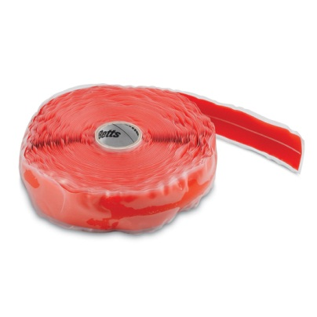
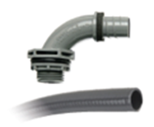
Liquid Ingress Protection
Thomas & Betts brands
for liquid ingress protection
Thomas & Betts is committed to protecting electrical systems with durable, innovative and sustainable solutions.
Carlon®
Iberville®
Red•Dot®
Reznor®
Shrink-Kon™
Shrink-KonTM
Self-Fusion Tape
Carlon®
Carflex® Nonmetallic
Conduit and Fittings

Slide 20
Thank You!!!

