Slide 1
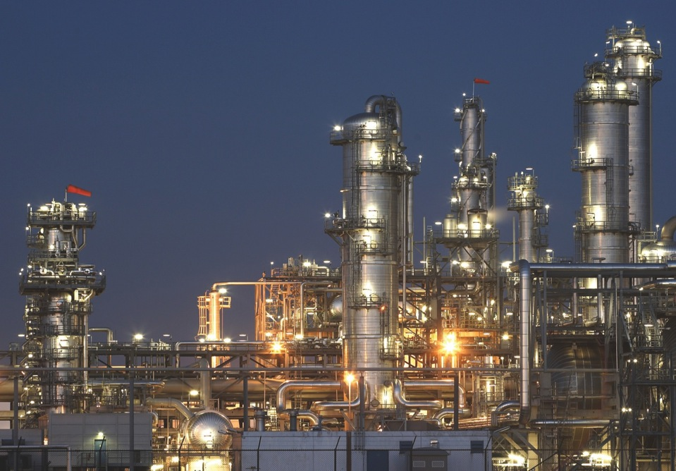

Electrical Solutions for the Oil and Gas Industry

Slide 2
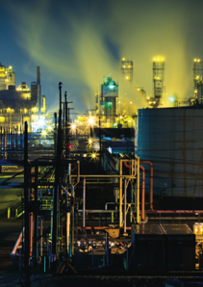
Key Oil and Gas Business Drivers
Maintaining a safe environment in process areas classified as hazardous locations
Unforgiving time schedules to meet investment deadlines
Battling corrosion (in all its many forms)
Managing unpredictable raw material costs
Adapting to changing technologies used to find energy sources
Increasing environmental and community demands

Slide 3
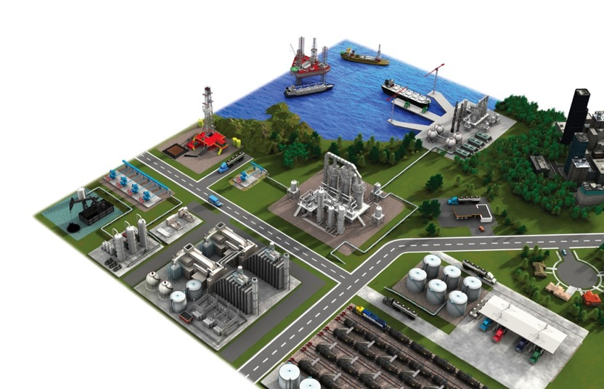
T&B Engineered
Solutions for Every
Application Area
Exploration
Production
Offshore
Onshore
Oilsands
Shale
Refining
Infrastructure
Storage
OEM/Skid Manufacturer
Transportation
Marketing

Slide 4









Oil and Gas Electrical System Issues
Safety
Continuous Operation & Sustainability
Total Project Cost Reduction
Corrosive & Harsh Environment Protection
Hazardous Location Protection
Grounding & Bonding
Power Quality, Efficiency & Reliability
Extreme Temperature Protection
Liquid Ingress Protection

Slide 5
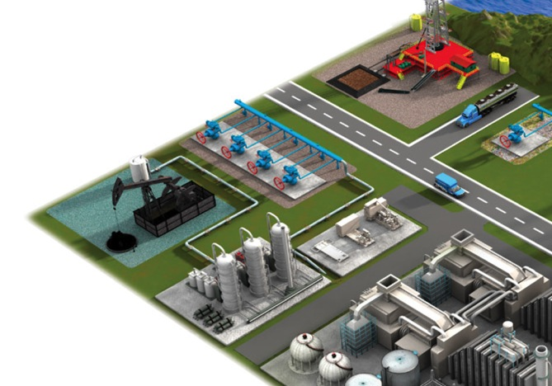

Safety

Slide 6
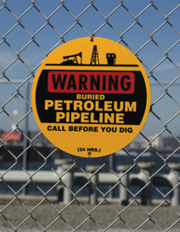





Safety
Thomas & Betts brands
for safety
The goal of safety practices is zero accidents, zero injuries and zero deaths.
The major stakeholders in safety solutions are:
Provincial and Federal agencies
Businesses/organizations
Employees
Environment/society
Blackburn®
Elastimold®
Emergi-Lite®
E-Z-CODE®
Fisher Pierce®
Hazlux®
Hi-Tech®
Joslyn Hi-Voltage®
Lumacell®
Ocal™
Ready-Lite®
Red•Dot®
Russellstoll®
Sta-Kon®
Superstrut®
Ty-Rap®
Hazlux®
Quick PoleTM
Russellstoll®
Safe Ground Indicator and Lightning Protection
Emergi-Lite®/ Lumacell® /Ready-Lite®
Emergency Lighting Systems
E-Z-CODE®
Safety Labels, Tags, Signs and Barricade Tapes

Slide 7

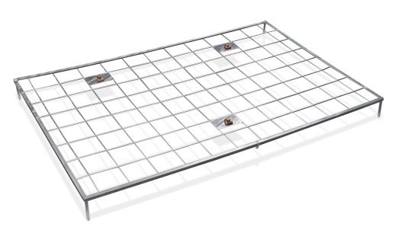
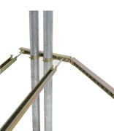
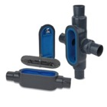
Safety
Thomas & Betts brands for safety
No one is immune to safety concerns.
Safety concerns are not market specific. They affect workers, production schedules and the bottom line across a broad spectrum of industries.
Blackburn®
Elastimold®
Emergi-Lite®
E-Z-CODE®
Fisher Pierce®
Hazlux®
Hi-Tech®
Joslyn Hi-Voltage®
Lumacell®
Ocal™
Ready-Lite®
Red•Dot®
Russellstoll®
Sta-Kon®
Superstrut®
Ty-Rap®
Ty-Rap®
Detectable Cable Ties
Blackburn®
Metallic Gradient Control Mat
Superstrut®
Seismic Bracing Syste^{m}
Ocal®
PVC-Coated Conduit & Fittings

Slide 8
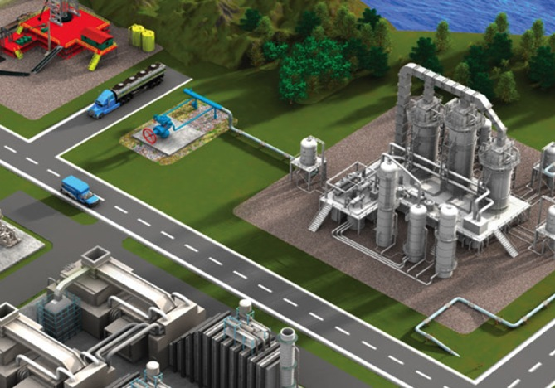

Continuous Operation & Sustainability

Slide 9
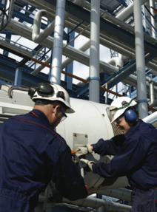
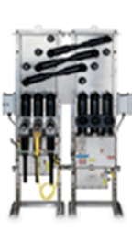


Continuous Operation & Sustainability
Thomas & Betts brands
for continuous operation
& sustainability
The costs associated with downtime in oil and gas operations can be as high as $1 million per hour.
If power is lost during production, the current production may have to be scrapped as well as the process equipment.
Blackburn®
Elastimold®
Homac®
Joslyn Hi-Voltage®
Ocal™
PMA®
Russellstoll®
Shrink-Kon™
Sta-Kon®
Superstrut®
T&B® Cable Tray
T&B® Fittings
Blackburn®
Motor Lead Disconnects
Elastimold®
Switchgear and cable accessories
Blackburn®
Compression Connectors
Featuring the Color-Keyed® System

Slide 10



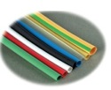
Continuous Operation & Sustainability
Thomas & Betts brands for continuous operation
& sustainability
In the single most demanding, non-stop operating environments, one single point of failure can lead to costly, or even disastrous, results.
Blackburn®
Elastimold®
Homac®
Joslyn Hi-Voltage®
Ocal™
PMA®
Russellstoll®
Shrink-Kon™
Sta-Kon®
Superstrut®
T&B® Cable Tray
T&B® Fittings
Russellstoll®
Pin-and-Sleeve Interconnections
OcalTM
PVC-Coated Conduit Systems
T&B Fittings®
Type A Nonmetallic Flexible Conduit and Fittings
Sta-Kon®
Shrink-KonTM Wire
and Connector Insulation

Slide 11
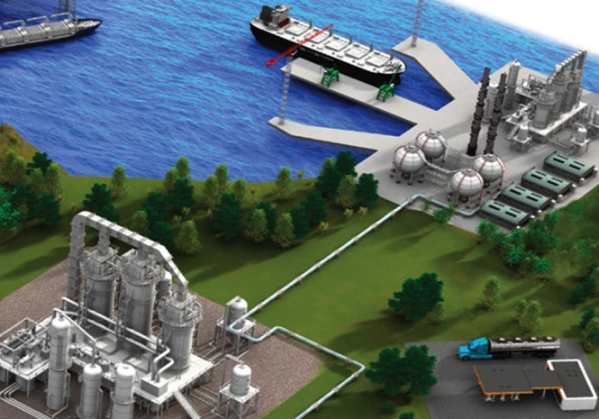

Total Project Cost Reduction

Slide 12
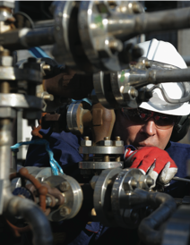
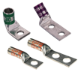


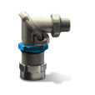
Total Project Cost Reduction
Thomas & Betts brands
for total project cost reduction
Thomas & Betts understands the needs of oil and gas producers. We deliver complete solutions that help reduce costs at every stage of construction, operation and maintenance.
Blackburn®
Hazlux®
Joslyn Hi-Voltage®
Superstrut®
T&B® Fittings
T&B® Fittings
RangerTM Cord Connectors
Blackburn®
Compression Lugs featuring the
Color-Keyed System
Hazlux®
Quick Pole
T&B® Fittings
Star TeckExtreme® Director™
Fittings

Slide 13
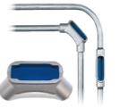



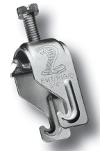
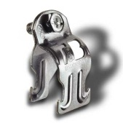

Total Project Cost Reduction
Thomas & Betts brands for total project cost reduction
Depending on the scope of the project, keeping a handle on total costs is a daunting but necessary task.
Thomas & Betts can assist you in your challenge to cut costs, without cutting corners.
Blackburn®
Hazlux®
Joslyn Hi-Voltage®
Superstrut®
T&B® Fittings
^{T&B® Fittings}
^{LUTM Universal Conduit Elbow}
^{Blackburn®}
^{HEX-FLEXTM Die System}
Superstrut®
Modular Framing System, Cobra Clamp, Quik Clamp and Trapnut® Strut Fastener

Slide 14
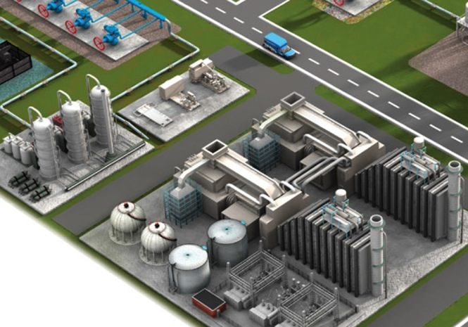

Corrosion & Harsh
Environment Protection

Slide 15
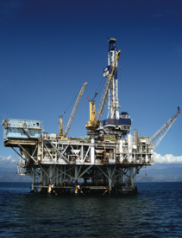
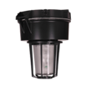



Corrosion & Harsh Environment Protection
Thomas & Betts brands for corrosion & harsh environment protection
Corrosion is the enemy of electrical systems. According to NACE International, corrosion costs in North America are estimated to be over $1.3 billion annually.
Problems caused by corrosion include:
Equipment failure and shortened life
Poor electrical system reliability caused by high-resistance connections
Long maintenance repair and downtime due to corroded parts
Safety hazards at the grounding level and from product contamination
Added labor expenses
Emergi-Lite®
Hazlux®
Kopex-Ex™
Lumacell®
Ocal™
PMA®
Ready-Lite®
Red•Dot®
Reznor®
Sta-Kon®
Superstrut®
T&B® Cable Tray
T&B® Fittings
Ty-Rap®
^{OcalTM}
^{OCAL-BLUETM PVC-Coated Conduit}
^{Hazlux®}
^{HazCote® Kynar} ^{Coated Lighting Fixtures}
^{Ty-Rap®}
^{Stainless Steel Cable Ties}
^{Kopex-Ex™}
Stainless Steel Flexible Conduit
^{and Liquidtight Fittings}

Slide 16
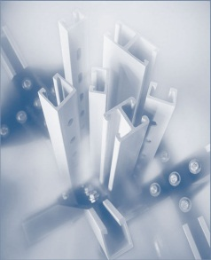
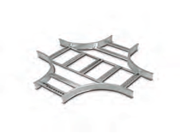

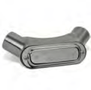
Corrosion & Harsh Environment Protection
Thomas & Betts brands
for corrosion & harsh environment protection
Corrosion is a natural and inevitable process. It cannot be eliminated, but it can be managed and controlled with the right products.
Emergi-Lite®
Hazlux®
Kopex-Ex™
Lumacell®
Ocal™
PMA®
Ready-Lite®
Red•Dot®
Reznor®
Sta-Kon®
Superstrut®
T&B® Cable Tray
T&B® Fittings
Ty-Rap®®
^{T&B® Cable Tray}
^{Aluminum Cable Tray}
^{Superstrut®}
Nonmetallic Channel and Accessories
^{PMA®}
^{Nylon Cable Protection Systems}
^{T&B® Fittings}
^{Type 316 Stainless Steel}
^{Form 8 Conduit Bodies}

Slide 17
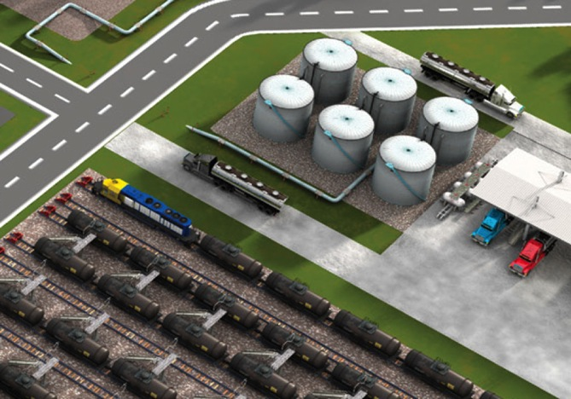

Hazardous Location Protection

Slide 18
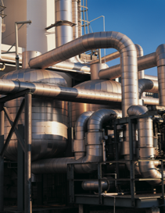

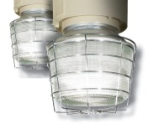

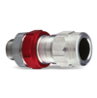
Hazardous Location Protection
Thomas & Betts brands
for hazardous location protection
There is always a concern at oil and gas installations about the significant presence of gases and vapors.
Typical hazardous locations include:
Onshore and offshore drilling rigs
Refineries and chemical plants
Booster stations and valve areas along pipelines
Loading and unloading areas in terminals
Tank storage areas, barrels and trucks
Emergi-Lite®
E-Z-CODE®
Hazlux®
Kopex-Ex™
Lumacell®
Ready-Lite®
Reznor®
Russellstoll®
T&B® Cable Tray
T&B®Fittings
Hazlux®
Industrial Lighting Fixtures
Russellstoll®
MaxGard® Explosion Proof
Pin-and-Sleeve Connectors
Reznor®
Explosion Resistant Heaters
T&B® Fittings
STAR TECK® XP Stainless Steel
and Aluminum Fittings

Slide 19
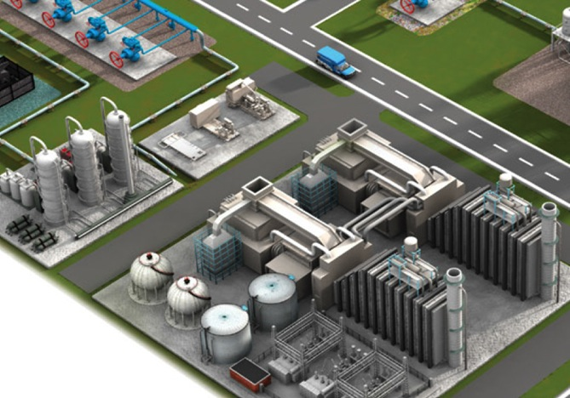

Grounding & Bonding

Slide 20
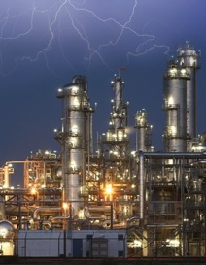


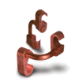

Grounding & Bonding
Thomas & Betts brands
for grounding & bonding
Grounding the electrical system provides a means by which conductive equipment is connected to an earth potential via the grounding electrode. This prevents potential differences and sparking between conductive equipment and grounded structures.
Blackburn®
Boreal™
Elastimold®
E-Z-CODE®
Fisher PierceTM
Russellstoll®
Sta-Kon®
T&B® Fittings
^{Blackburn®}
^{Exothermic Welding System}
^{Blackburn®}
Mechanical Grounding Connectors
^{Blackburn®}
E-Z-Ground® Compression Connectors
^{Boreal™}
High-Quality Flexible Connectors

Slide 21


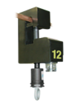

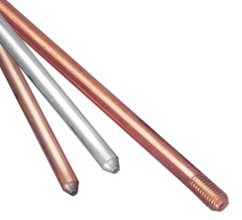
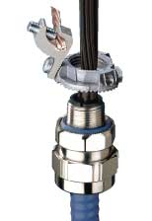

Grounding & Bonding
Thomas & Betts brands
for grounding & bonding
An improperly installed or grounded electrical system can cause power failure which often leads to significant safety, production and operational concerns.
Blackburn®
Boreal™
Elastimold®
E-Z-CODE®
Fisher PierceTM
Russellstoll®
Sta-Kon®
T&B® Fittings
Fisher PierceTM
Faulted Circuit Indicator
^{Russellstoll®}
^{Safe Ground Indicator System}
Blackburn®
Ground Rods
^{T&B® Fittings}
^{Grounding Fittings}

Slide 22
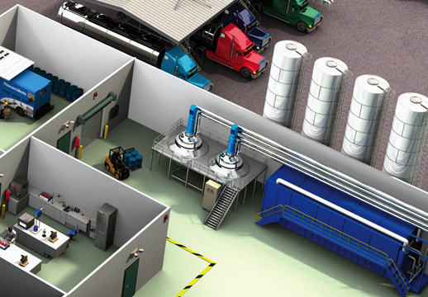

Power Quality, Efficiency & Reliability

Slide 23
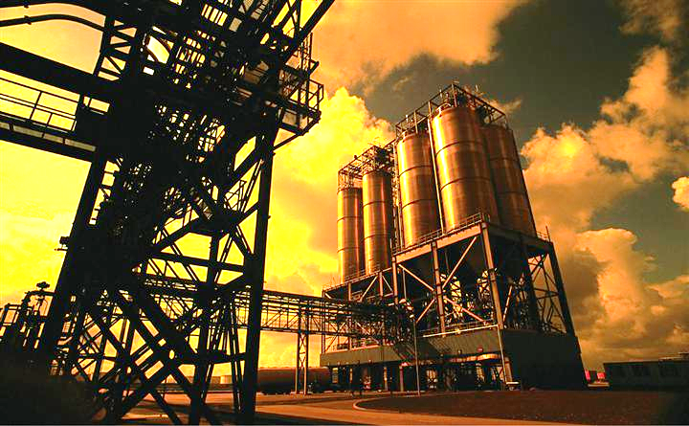

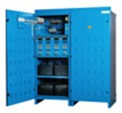
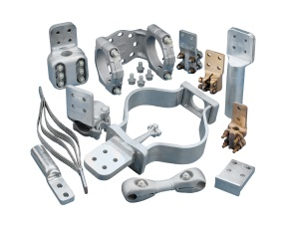
Power Quality, Efficiency & Reliability
Thomas & Betts brands
for power quality, efficiency & reliability
The loss of a single data record can mean the permanent loss of a process batch. In continuous operations, missing data translates to the loss of thousands of dollars every minute. In this critical industry, the need for stable power is paramount.
Blackburn®
Elastimold®
Emergi-Lite®
Fisher PierceTM
Hi-TechTM
Homac®
Joslyn Hi-Voltage®
Lumacell®
Ready-Lite®
Russellstoll®
Elastimold®
Solid Dielectric Switchgear
Emergi-Lite® /Lumacell® /Ready-Lite®
Central Battery Systems
Homac®
Substation Connectors

Slide 24
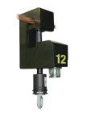

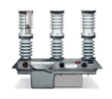

Power Quality, Efficiency & Reliability
Thomas & Betts brands
for power quality, efficiency & reliability
In today’s world, critical electrical equipment must be reliable and operational — 24 hours a day, seven days
a week.
Blackburn®
Elastimold®
Emergi-Lite®
Fisher Pierce®
Hi-TechTM
Homac®
Joslyn Hi-Voltage®
Lumacell®
Ready-Lite®
Russellstoll®
Fisher PierceTM
Faulted Circuit Indicators
Joslyn®
Switches and Reclosers
Elastimold®
Cable Accessories

Slide 25
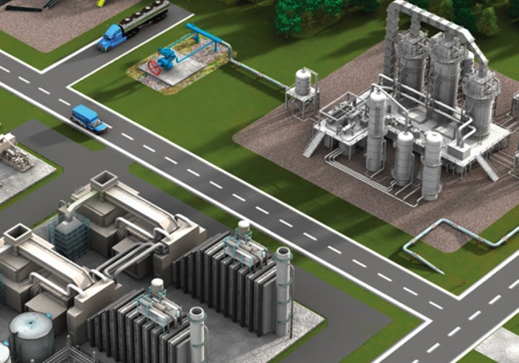

Extreme Temperature Protection

Slide 26
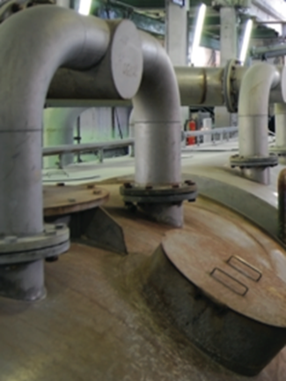

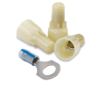


Extreme Temperature Protection
Thomas & Betts brands
for extreme temperature protection
Electrical systems need to perform consistently in boiler rooms, furnace operations and around evaporators. Many of these processes require heat tracing to maintain elevated temperatures throughout oil and gas process systems.
E-Z-CODE®
Kopex-Ex™
PMA®
Sta-Kon®
T&B® Fittings
Ty-Rap®
Ty-Rap®
Extra-High Temperature
and Fluoropolymer Ties
Sta-Kon®
High-Temperature Wire Joints
and Terminals
T&B® Fittings
ATX Liquidtight Flexible Metal Conduit and Fittings
PMA®
High-Temperature Nylon Conduit
and Fittings

Slide 27


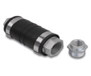

Extreme Temperature Protection
Thomas & Betts brands for extreme temperature protection
Excessive heat or cold can wreak havoc on an electrical system, potentially causing critical components to fail.
E-Z-CODE®
Kopex-Ex™
PMA®
Sta-Kon®
T&B® Fittings
Ty-Rap®
KopexTM
High-Temperature
Conduit Systems
Ty-Rap®
High Temperature Cable Ties
T&B® Fittings
XD Expansion Fitting
T&B ® Fittings
HT Series High Temperature Flexible Metal Liquidtight fittings

Slide 28
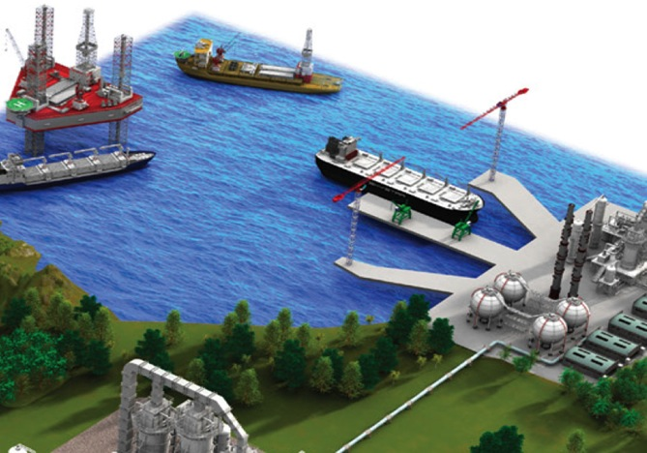

Liquid Ingress Protection

Slide 29
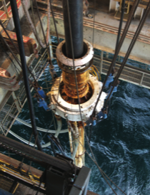




Liquid Ingress Protection
Thomas & Betts brands for liquid ingress protection
A single drop of contaminant seeping into an electrical control box is all it takes to knock out an oil and gas facility’s production line for days.
Emergi-Lite®
Hazlux®
Homac®
Kopex-Ex™
Lumacell®
Ocal™
PMA®
Ready-Lite®
Red•Dot®
Reznor®
Russellstoll®
Sta-Kon®
Shrink-KonTM
T&B®Fittings
Homac®
Flood-Seal®and Squid® Products
Russellstoll®
MaxGard® Pin-and-Sleeve Connectors
T&B® Fittings
Stainless Steel Liquidtight Conduit and Cord Fittings
OcalTM
OCAL-BLUETM PVC-Coated NEMA Type 4X Form 8 Conduit Bodies

Slide 30



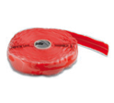

Liquid Ingress Protection
Thomas & Betts brands for liquid ingress
protection
The financial impact of allowing liquid to migrate into electrical systems can be significant — whether the result of downtime or having to replace damaged components.
Emergi-Lite®
Hazlux®
Homac®
Kopex-Ex™
Lumacell®
Ocal™
PMA®
Ready-Lite®
Red•Dot®
Reznor®
Russellstoll®
Sta-Kon®
Shrink-KonTM
T&B® Fittings
Red•Dot®
Code KeeperTM Weatherproof
While-In-Use Covers
PMA®
Flexible Nylon Conduit Systems
Homac®
Flood-Seal® Multi-Port Connectors
Shrink-KonTM
Insulation Products

Slide 31
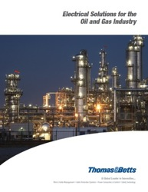
Thank You!!!

