Slide 1
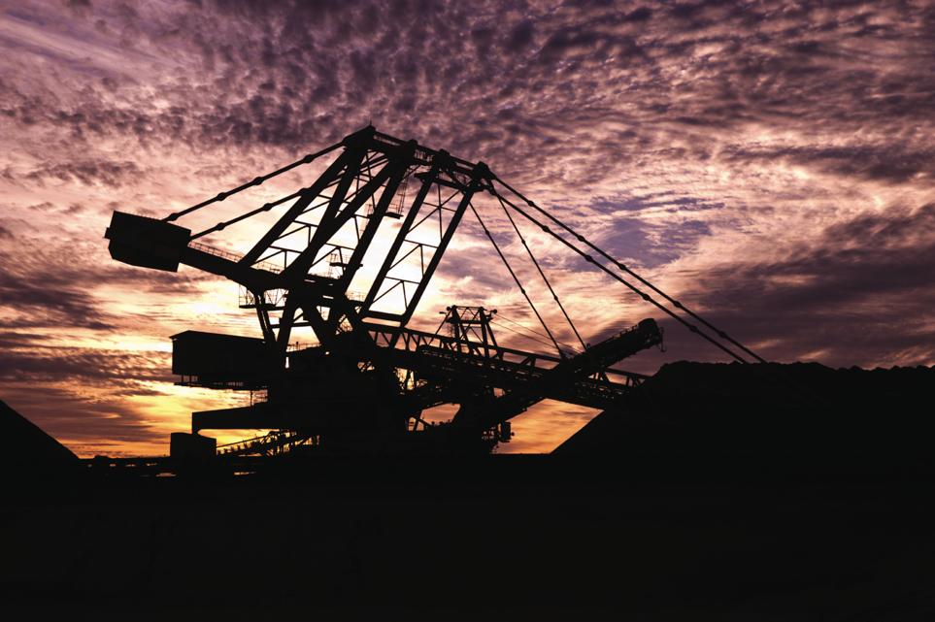

Electrical Solutions for Metals and Mining Industry

Slide 2
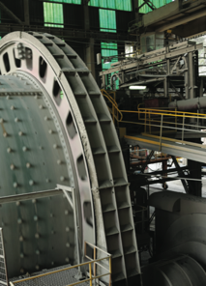
Key Metals and Mining Business Drivers
Minimize operation and maintenance costs
Maximize plant availability and throughput
Ensure safety for personnel, machinery, materials and the property
Conserve natural resources and reduce emissions
Save energy

Slide 3
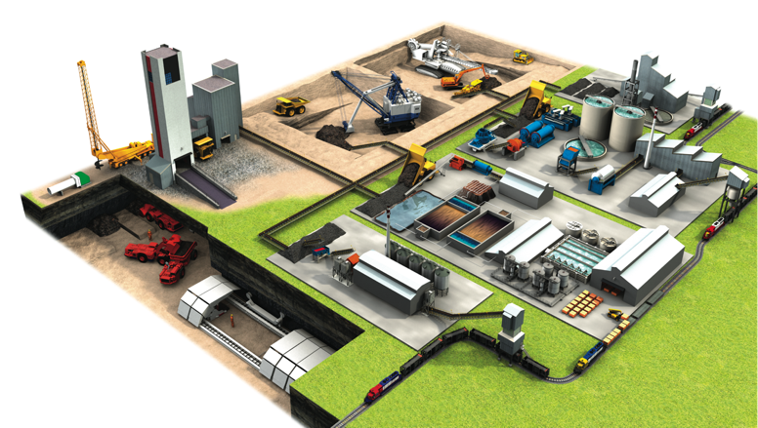
T&B Engineered
Solutions for Every
Application Area
Power Plant
Transmission and Distribution Substations
Mine Electrification and Lighting
Electrical Control Rooms
Ore Extraction
Conveyors
Beneficiation
Mineral Processing
Water and Waste Management
Smelting and Refining
Metalforming

Slide 4








Electrical System Issues for Metals and Mining
Continuous Operation & Sustainability
Corrosion & Harsh Environment Protection
Liquid Ingress Protection
Safety
Extreme Temperature Protection
Hazardous Location Protection
Power Quality, Efficiency & Reliability
Grounding & Bonding

Slide 5
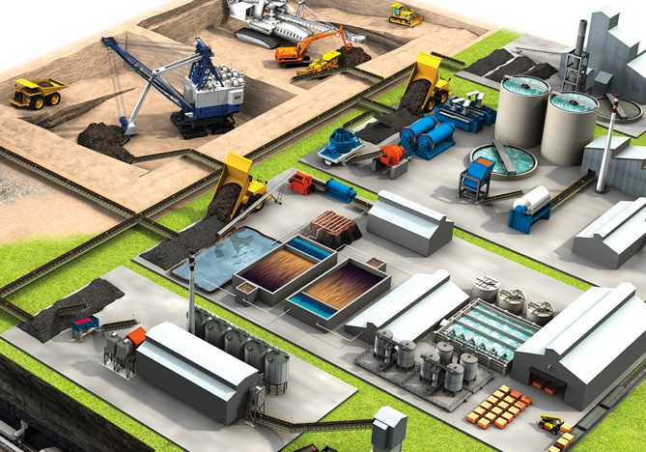

Continuous Operation & Sustainability

Slide 6
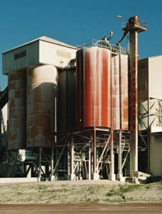

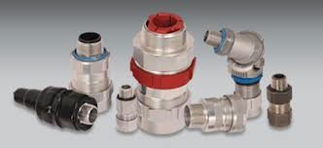




Continuous Operation
& Sustainability
Thomas & Betts brands
for continuous operation
& sustainability
Mining and metallurgy plants need skilled operators and good maintenance management to produce at sustainable yields. But costs associated with unscheduled downtime — replacement of ruined equipment, idle manpower, late-penalty fees, rental equipment expenses and intangibles for dissatisfied customers — can add up quickly.
Blackburn®
Carlon®
Elastimold®
Emergi-Lite®
Hazlux®
Homac®
Kopex-Ex™
Lumacell®
Ocal™
PMA®
Ready-Lite®
Red•Dot®
Russellstoll®
Sta-Kon®
Superstrut®
T&B® Fittings
T&B® Fittings
Star Teck® Fittings
Elastimold®
Switchgear and Cable Accessories
Blackburn®
Motor Lead Disconnects
Sta-Kon®
Crimped Wire Termination Systems

Slide 7
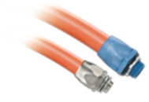

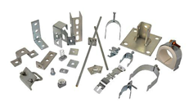
Continuous Operation
& Sustainability
Thomas & Betts brands
for continuous operation
& sustainability
In the single most demanding, non-stop operating environments, one single point of failure can lead
to costly, or even disastrous, results.
Blackburn®
Carlon®
Elastimold®
Emergi-Lite®
Hazlux®
Homac®
Kopex-Ex™
Lumacell®
Ocal™
PMA®
Ready-Lite®
Red•Dot®
Russellstoll®
Sta-Kon®
Superstrut®
T&B® Fittings
T&B® Fittings
Liquatite® Flexible Metallic
and Nonmetallic Conduit
Russellstoll®
MaxGard® Interconnection System
Superstrut®
Steel, 316 Stainless, Aluminum,
PVC-Coated or Nonmetallic
Channel, Hangers and Clamps

Slide 8
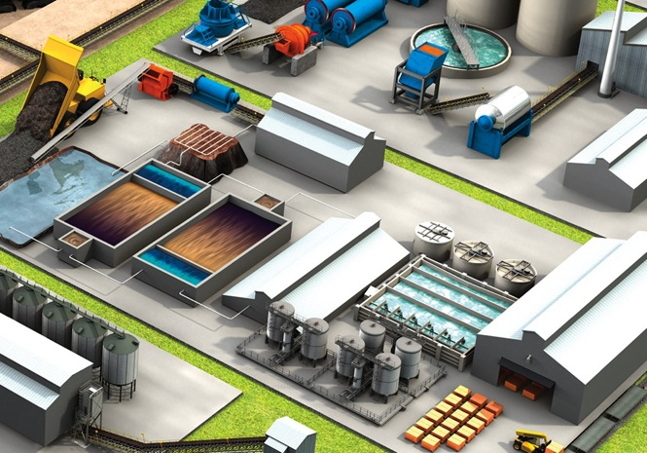

Corrosion & Harsh
Environment Protection

Slide 9
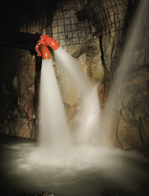



Corrosion & Harsh Environment Protection
Thomas & Betts brands
for corrosion & harsh environment protection
Corrosion — the enemy of electrical systems — costs an estimated $2.1 billion annually in lost equipment, labor and downtime.
Problems caused by corrosion include:
Equipment failure and shortened life
Poor electrical system reliability caused by
high-resistance connections
Long maintenance repair time due to corroded parts
Safety hazards and product contamination
Carlon®
Emergi-Lite®
Hazlux®
Homac®
Kopex-Ex™
Lumacell®
Ocal™
PMA®
Ready-Lite®
Red•Dot®
Reznor®
Sta-Kon®
Superstrut®
T&B®Cable Tray
T&B® Fittings
Ty-Rap®
Ocal™
OCAL-BLUE® PVC-Coated Conduit
Ty-Rap®
Stainless Steel Cable Ties
T&B® Fittings
Stainless Steel Liquidtight
Conduit Fittings
T&B® Cable Tray
Stainless Steel Cable Tray

Slide 10
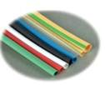


Corrosion & Harsh Environment Protection
Thomas & Betts brands
for corrosion & harsh environment protection
Corrosion is a natural and inevitable process.
It cannot be eliminated, but it can be managed and controlled with the right products.
Carlon®
Emergi-Lite®
Hazlux®
Homac®
Kopex-Ex™
Lumacell®
Ocal™
PMA®
Ready-Lite®
Red•Dot®
Reznor®
Sta-Kon®
Superstrut®
T&B® Cable Tray
T&B® Fittings
Ty-Rap®
T&B® Fittings
Stainless Steel Form 8 and
BlueKoteTM Conduit Bodies
Shrink-Kon™
Insulation Products
^{T&B® Fittings}
Stainless Steel Liquidtight Conduit and Cord Fittings

Slide 11
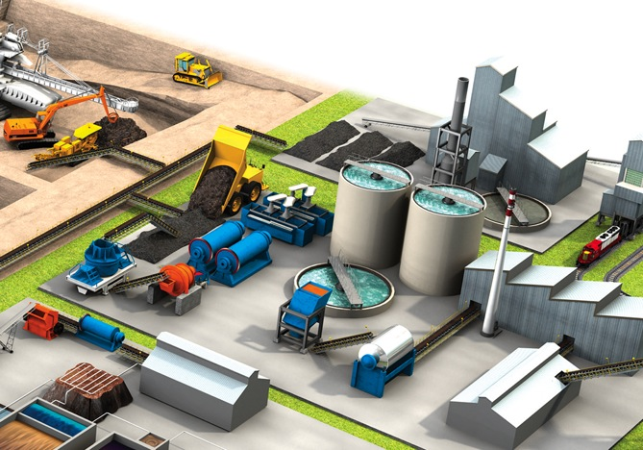

Liquid Ingress Protection

Slide 12
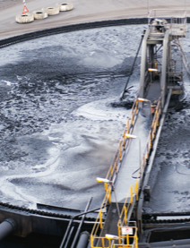



Liquid Ingress Protection
Thomas & Betts brands for liquid ingress protection
Liquid ingress protection is a critical element in keeping electrical systems operational. Exposure to water in indoor or outdoor applications, dust in suspension, condensation and accidental spills of machine oils and lubricants can all shorten the life of your electrical system. One drop can be enough to ruin your production systems and processes.
Carlon®
Elastimold®
Emergi-Lite®
Hazlux®
Homac®
Kopex-Ex™
Lumacell®
Ocal™
PMA®
Ready-Lite®
Reznor®
Russellstoll®
Sta-Kon®
Superstrut®
T&B® Fittings
Russellstoll®
DuraGard® Pin-and-Sleeve Connectors
T&B® Fittings
Stainless Steel Liquidtight
Conduit and Cord Fittings
Red•Dot®
Code KeeperTM Weatherproof Covers

Slide 13
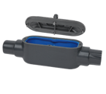

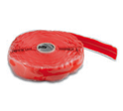
Liquid Ingress Protection
Thomas & Betts brands for liquid ingress protection
The financial impact of allowing liquid to migrate into electrical systems can be significant — whether the result of downtime or having to replace damaged components.
Carlon®
Elastimold®
Emergi-Lite®
Hazlux®
Homac®
Kopex-Ex™
Lumacell®
Ocal™
PMA®
Ready-Lite®
Reznor®
Russellstoll®
Sta-Kon®
Superstrut®
T&B® Fittings
Ocal™
OCAL-BLUETM Type 4X
Form 8 Conduit Bodies
^{PMA®}
^{Flexible Nylon Conduit Systems}
^{Shrink-Kon™}
Wire and Connector Insulation Products

Slide 14
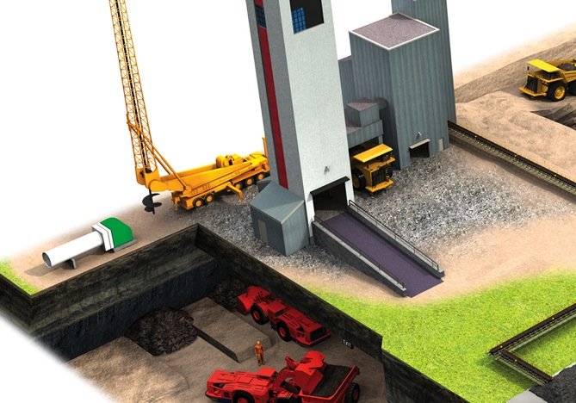

Safety

Slide 15
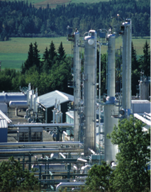



Safety
Thomas & Betts brands for safety
During the years 2000–2009, electrical accidents were the leading cause of fatalities in the U.S. mining industry, accounting for 6% of all deaths. Electrical injuries in mining are also disproportionately deadly, with 1 out of every 22 such injuries ending in a fatality, compared with an average of 1 out of every 203 for all other types of injuries.*
Blackburn®
Emergi-Lite®
E-Z-Code®
Fisher PierceTM
Hazlux®
Homac®
Joslyn Hi-Voltage®
Kopex-Ex™
Lumacell®
PMA®
Ready-Lite®
Red•Dot®
Russellstoll®
Sta-Kon®
Superstrut®
T&B® Fittings
Ty-Rap®
* Source: U.S. Occupational Safety and Health,
http://www.cdc.gov/niosh/mining/topicspage1.htm
Ty-Rap®
Flame Retardant Cable Ties
Emergi-Lite® /Lumacell® /Ready-Lite®
Emergency Lighting
E-Z-Code®
Safety Labels, Tags,
Signs and Barricade Tapes

Slide 16



Safety
Thomas & Betts brands for safety
No one is immune to safety concerns. They affect workers, production schedules and the bottom line across a broad spectrum of industries.
Blackburn®
Emergi-Lite®
E-Z-Code®
Fisher PierceTM
Hazlux®
Homac®
Joslyn Hi-Voltage®
Kopex-Ex™
Lumacell®
PMA®
Ready-Lite®
Red•Dot®
Russellstoll®
Sta-Kon®
Superstrut®
T&B® Fittings
Ty-Rap®
Russellstoll®
Safe Ground Indicator System
Russellstoll®
Safety Interlocks

Slide 17
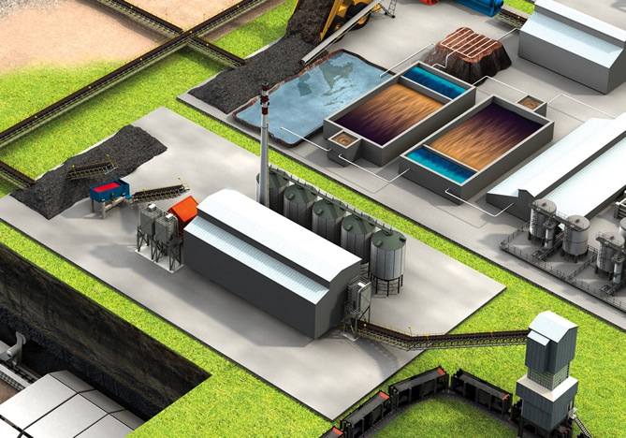

Extreme Temperature Protection

Slide 18
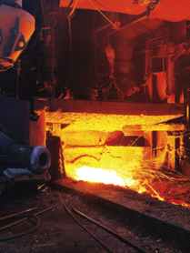

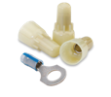

Extreme Temperature Protection
Thomas & Betts brands for extreme temperature protection
Outdoor and indoor machinery and process equipment at metal processing, coal and cement plants must stand up to extreme temperatures, UV radiation, humidity and corrosive substances. Electrical systems must perform in these harsh conditions and be protected against condensation, water and sludge.
E-Z-Code®
Kopex-Ex™
PMA®
Shrink-KonTM
Sta-Kon®
T&B® Fittings
Ty-Rap®
Ty-Rap®
Extra-High Temperature
and Stainless Steel Ties
Sta-Kon®
High-Temperature Wire Joints
and Terminals
T&B® Fittings
ATX Liquiatite® Flexible
Metal Conduit and Fittings

Slide 19



Extreme Temperature Protection
Thomas & Betts brands for extreme temperature protection
Excessive heat or cold can wreak havoc on an electrical system, potentially causing critical components to fail.
E-Z-Code®
Kopex-Ex™
PMA®
Shrink-KonTM
Sta-Kon®
T&B® Fittings
Ty-Rap®
PMA®
High-Temperature Nylon
Conduit and Fittings
E-Z-Code®
Safety Labels, Tags,
Signs and Barricade Tapes

Slide 20
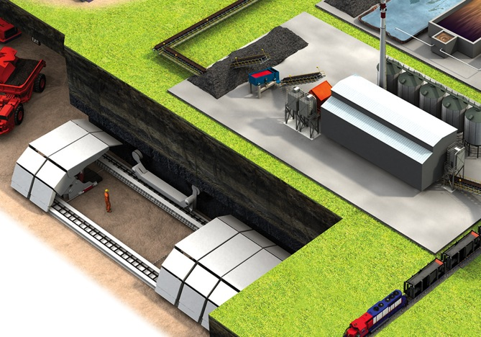

Hazardous Location Protection

Slide 21
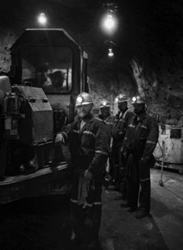
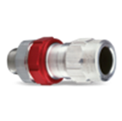



Hazardous Location Protection
Thomas & Betts brands
for hazardous location
protection
Gases and vapors always pose a concern in garages, hangers and other areas classified as hazardous. Our explosion-proof solutions can prevent or contain an explosion in classified hazardous locations.
Emergi-Lite®
E-Z-Code®
Hazlux®
Kopex-Ex™
Lumacell®
Ready-Lite®
Reznor®
Russellstoll®
T&B® Cable Tray
T&B® Fittings
T&B® Fittings
Star Teck XP® Explosion Proof
Teck Fittings
Russellstoll®
MaxGard® Explosion-Proof
Interlocked Receptacles
T&B® Fittings
XP Explosion-Proof Enclosure Flexible Couplings
Hazlux®
Hazardous Location Lighting

Slide 22
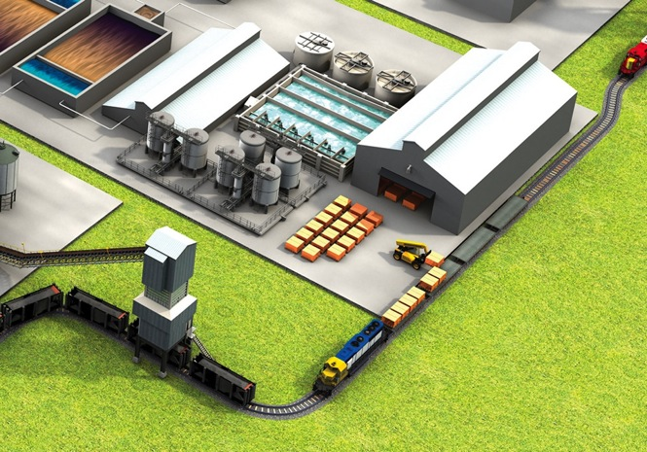

Power Quality, Efficiency & Reliability

Slide 23
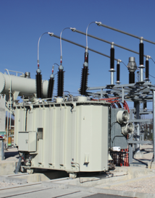

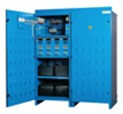
Power Quality, Efficiency
& Reliability
Thomas & Betts brands
for power quality, efficiency & reliability
When reliable connection and intelligent control of electrical power are necessities, Thomas & Betts Power Connection and Control/Uninterruptible systems offer a wide selection of products. From 120V to 230kV, our products are specified worldwide in the industrial, construction and utility markets.
Blackburn®
Elastimold®
Emergi-Lite®
Fisher PierceTM
Hi-TechTM
Homac®
Joslyn Hi-Voltage®
Lumacell®
Ready-Lite®
Russellstoll®
Elastimold®
Solid Dielectric Switchgear
Emergy-Lite® /Lumacell® /Ready-Lite®
Central Battery Systems

Slide 24
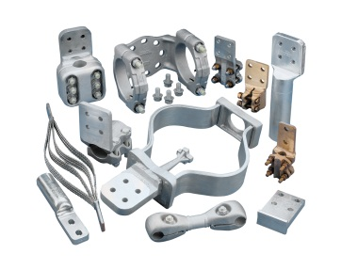

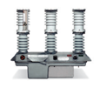
Power Quality, Efficiency
& Reliability
Thomas & Betts brands
for power quality, efficiency & reliability
In today’s world, critical electrical equipment must be reliable and operational — 24 hours a day, seven days a week.
Blackburn®
Elastimold®
Emergi-Lite®
Fisher PierceTM
Hi-TechTM
Homac®
Joslyn Hi-Voltage®
Lumacell®
Ready-Lite®
Russellstoll®
^{Homac®}
^{Substation Connectors}
^{Joslyn Hi-Voltage®}
^{Switches and Reclosers}

Slide 25
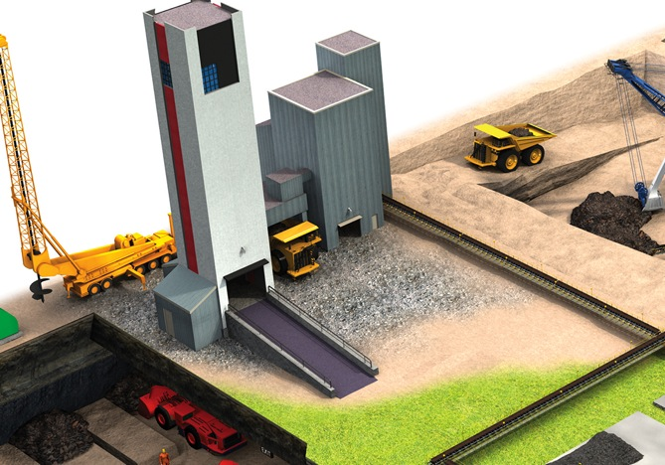

Grounding & Bonding

Slide 26
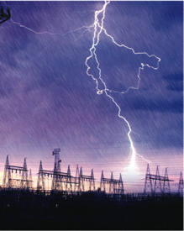
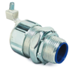


Grounding & Bonding
Thomas & Betts brands
for grounding & bonding
Grounding and bonding are achieved in many ways. Thomas & Betts provides grounding and bonding products that can meet exothermic, compression and mechanical requirements. A ground is a critical part of an electrical system. In some cases, additional grounding connections and electrodes are used to ensure operations are not interrupted.
Blackburn®
Boreal®
E-Z-Code®
Russellstoll®
T&B® Fittings
Boreal®
High-Quality Flexible Connectors
T&B® Fittings
Grounding Fittings
^{Blackburn®}
Mechanical Grounding Connectors

Slide 27
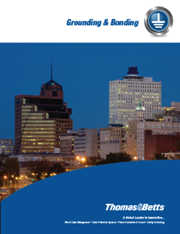



Grounding & Bonding
Thomas & Betts brands
for grounding & bonding
An improperly installed or grounded electrical system can cause power failure, which often leads to significant safety, production and operational concerns.
Blackburn®
Boreal®
E-Z-Code®
Russellstoll®
T&B® Fittings
Blackburn®
Exothermic Welding System
Russellstoll®
Ground Indicator System
^{Blackburn®}
E-Z-Ground® Compression Connectors

Slide 28
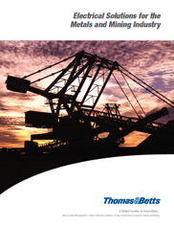
Thank You!!!

