Slide 1


Electrical Solutions for Commercial & Institutional Facilities

Slide 2
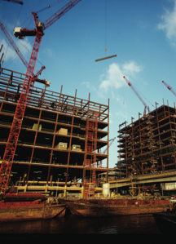
Key Business Drivers for Commercial and Institutional Construction
Improve operational efficiencies while maintaining high quality
Provide for the safety of employees and future building tenants
Complete projects profitably, on time and within budget

Slide 3
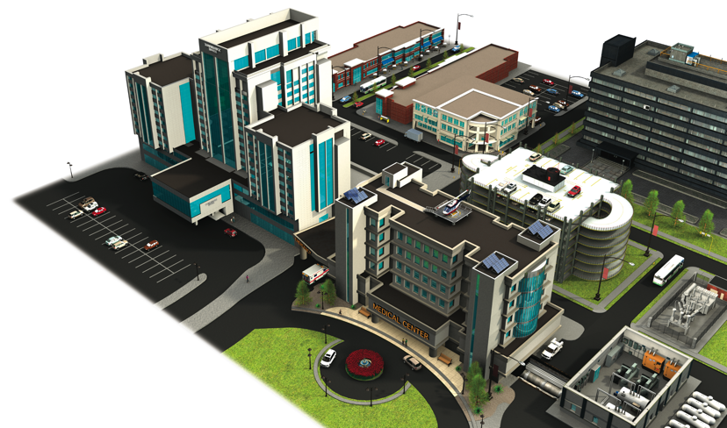
T&B Engineered
Solutions for Every
Project
Healthcare
Educational
Retail
Hospitality
Office
Data Centers

Slide 4






Electrical System Issues for Commercial and Institutional Facilities
Total Project Cost Reduction
Continuous Operation & Sustainability
Grounding & Bonding
Safety
Power Quality, Efficiency & Reliability
Liquid Ingress Protection

Slide 5
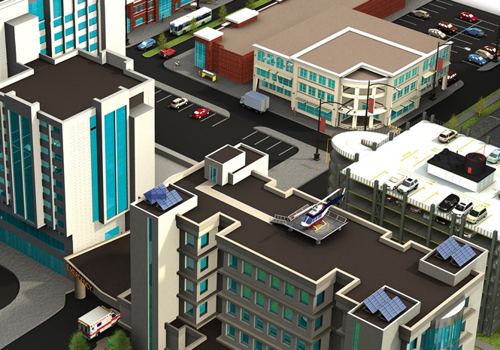

Total Project Cost Reduction

Slide 6
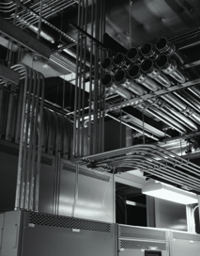

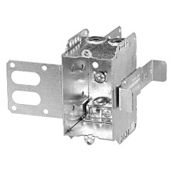
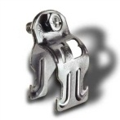
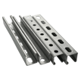
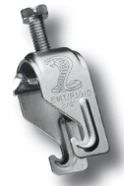
Total Project Cost Reduction
Thomas & Betts brands
for total project cost
reduction
Much of an electrical contractor’s time is spent on labor-intensive rough-in tasks, assembling the thousands of components that come together in a wall or ceiling to route, terminate, support and protect a complex commercial or institutional electrical system.
Material handling aspects — getting all of the components to the proper location on the jobsite — can be a time consuming, labor-intensive process as well.
Blackburn®
Carlon®
Iberville®
Marrette®
Reznor®
Steel City®
Superstrut®
T&B® Cable Tray
Carlon®
ENT System
Iberville®
Steel Stud Boxes
Superstrut®
Modular Metal
Framing System

Slide 7

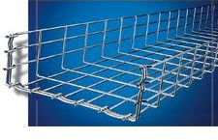
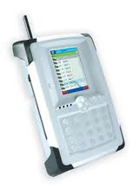
Total Project Cost Reduction
Thomas & Betts brands
for total project cost
reduction
In today’s challenging economic environment, projects that were recently considered “a go” are now getting a second look and closer scrutiny.
The main goal is to improve total project profitability and help make even marginal projects viable.
Thomas & Betts can assist you in your challenge
to cut costs, without cutting corners.
Blackburn®
Carlon®
Emergi-Lite®
Iberville®
Lumacell®
Marrette®
Ready-Lite®
Reznor®
Superstrut®
T&B® Cable Tray
Express Tray®
Wire Basket Tray
Blackburn®
Compression Connectors
Featuring the Color-Keyed® System
Emergi-Lite® /Lumacell® /Ready-Lite®
Emergency Lighting Management System

Slide 8
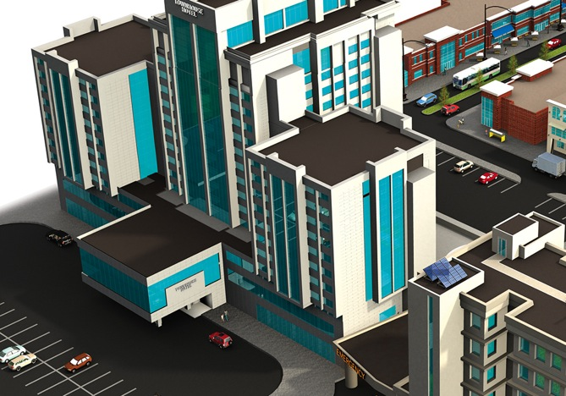

Continuous Operation & Sustainability

Slide 9
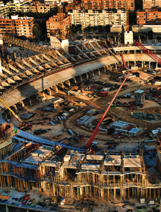



Continuous Operation & Sustainability
Thomas & Betts brands
for continuous operation
& sustainability
Technology and regulatory evolution are driving
change throughout commercial and institutional
facilities. Thomas & Betts is focused on providing
innovative electrical solutions that are not only highly
durable and maintain integrity over time, but are also flexible to efficiently accommodate future demands.
Carlon®
Elastimold®
Emergi-Lite®
Iberville®
Lumacell®
Marrette®
Ready-Lite®
Red•Dot®
Reznor®
Shrink-KonTM
Sta-Kon®
Steel City®
T&B® Cable Tray
Elastimold®
Solid-Dielectric Switchgear
Red Dot®
Code KeeperTM Weatherproof
While-in-Use Covers
Steel City®
68-HP Floor Boxes

Slide 10
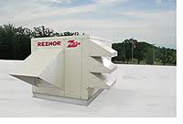


Continuous Operation & Sustainability
Thomas & Betts brands
for continuous operation
& sustainability
In the single most demanding, non-stop operating environments, one single point of failure can lead
to costly — or even disastrous — results.
Carlon®
Elastimold®
Emergi-Lite®
Iberville®
Lumacell®
Marrette®
Ready-Lite®
Red•Dot®
Carlon®
Reznor®
Shrink-KonTM
Sta-Kon®
Steel City®
T&B® Cable Tray
Reznor®
Heating Cooling Make-Up Air Systems
Steel City®
665-AV2 Floor Boxes
Elastimold®
Separable Connectors

Slide 11
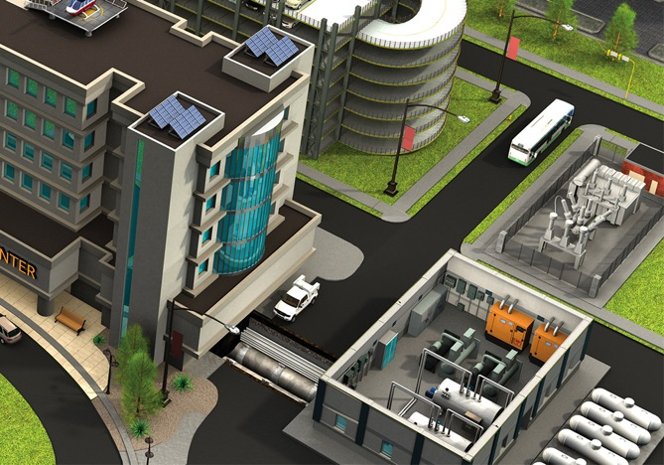

Grounding & Bonding

Slide 12
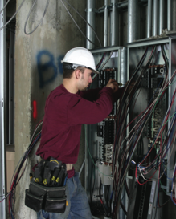
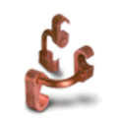
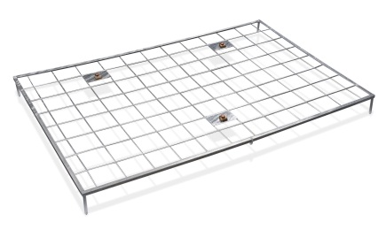
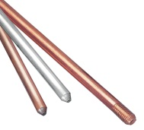

Grounding & Bonding
Thomas & Betts brands
for grounding & bonding
A stable, reliable power supply is the backbone of any building, plant or facility. Power failure or instability as the result of inadequately designed systems can cause major safety, production and operational concerns.
Blackburn®
Boreal®
Iberville®
Sta-Kon®
T&B® Fittings
Blackburn®
E-Z-Ground®
Compression Connectors
BlackBurn®
Metallic Gradient Ground Mat
Blackburn®
Ground Rods
Boreal®
Flexible Braids

Slide 13
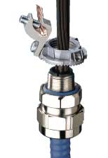

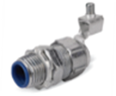
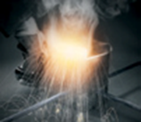
Grounding & Bonding
Thomas & Betts brands
for grounding & bonding
An improperly installed or grounded electrical system can cause power failure, which often leads to safety concerns.
Blackburn®
Boreal®
Iberville®
Sta-Kon®
T&B® Fittings
T&B® Fittings
Bond Star®
Blackburn®
Mechanical
Grounding Connectors
T&B® Fittings
RevolverTM Grounding Fittings
Blackburn®
Exothermic Welding System

Slide 14
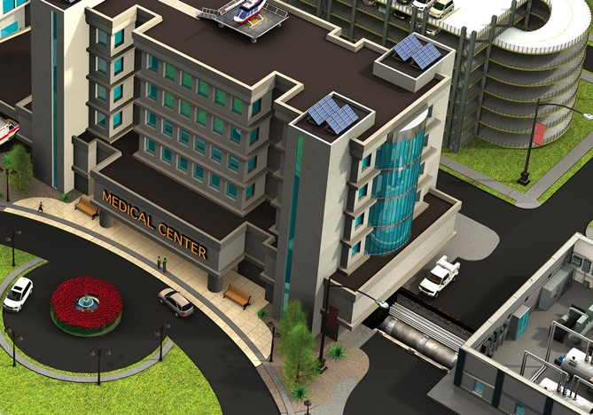

Safety

Slide 15
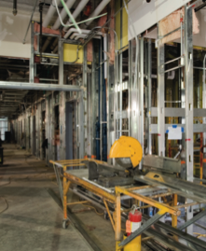



Safety
Thomas & Betts brands
for safety
Thomas & Betts is committed to bringing to market solutions that provide a safer installation as well as a safer working or living environment.
Carlon®
Emergi-Lite®
E-Z-CODE®
Lumacell®
Marrette®
Ready-Lite®
Steel City®
Superstrut®
T&B® Fittings
Ty-Rap®
Ty-Rap®
Detectable Cable Ties
Emergi-Lite® /Lumacell® /Ready-Lite®
Emergency Exit Lighting
EZCODE®
Safety Labels, Tags,
Signs and Barricade Tapes

Slide 16

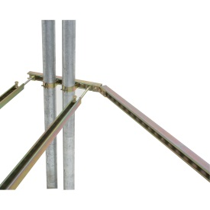
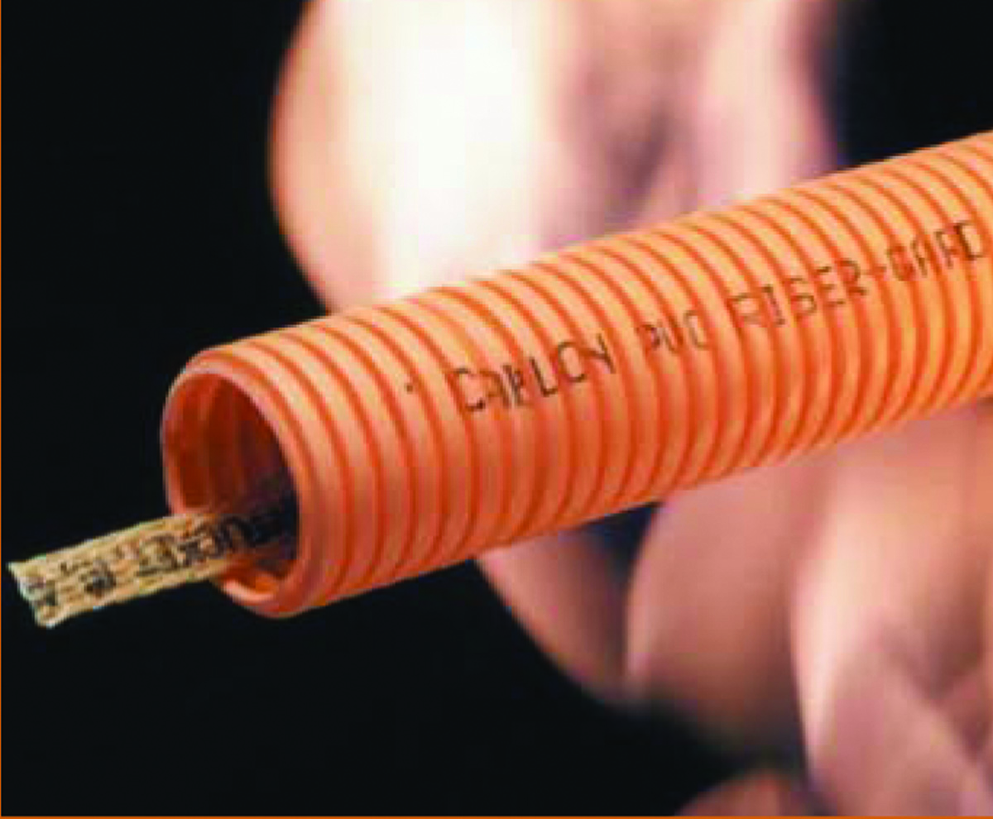
Safety
Thomas & Betts brands
for safety
No one is immune to safety concerns.
Contamination and safety concerns are not market
specific. They affect workers, construction schedules
and the bottom line across a broad spectrum
of industries.
Carlon®
Emergi-Lite®
E-Z-CODE®
Lumacell®
Marrette®
Ready-Lite®
SteelCity®
Superstrut®
T&B® Fittings
Ty-Rap®
Ty-Rap®
Flame-Retardant Cable Ties
Supestrut®
Seismic Bracing System
Carlon®
Hal-Free Riser GardTM
Halogen-free Nonmetallic Flexible Raceway

Slide 17
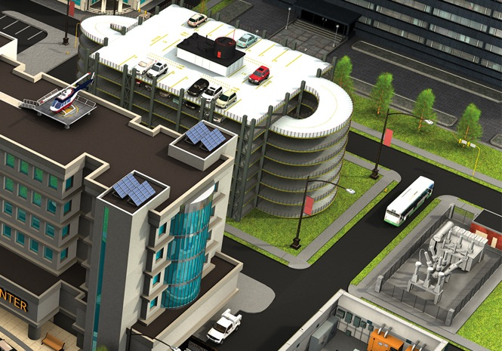

Power Quality, Efficiency & Reliability

Slide 18
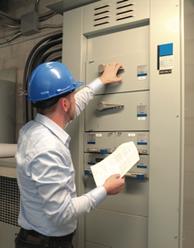
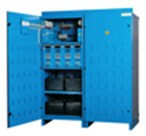
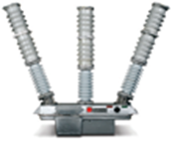
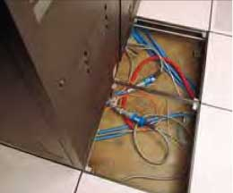
Power Quality, Efficiency & Reliability
Thomas & Betts brands
for power quality,
efficiency & reliability
Thomas & Betts power solutions provide peace
of mind that comes from knowing equipment is safe
from the consequences of unpredictable power.
Blackburn®
Elastimold®
Emergi-Lite®
Fisher-PierceTM
Hi-TechTM
Homac®
Joslyn Hi-Voltage®
Lumacell®
Microlectric®
Ready-Lite®
Russellstoll®
Emergi-lite® /Lumacell ® /Ready-Lite®
Central Battery Systems
Joslyn Hi-Voltage®
Reclosers
Russellstoll®
Computer System Plugs, Connectors and Receptacles

Slide 19
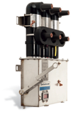
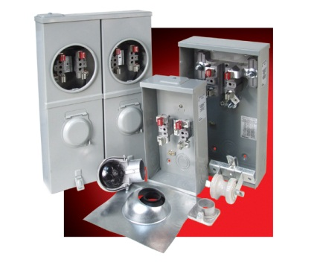
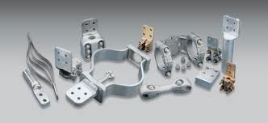
Power Quality, Efficiency & Reliability
Thomas & Betts brands
for power quality,
efficiency & reliability
In today’s world, critical electrical equipment
must be reliable and operational — 24 hours a day,
seven days a week.
Blackburn®
Elastimold®
Emergi-Lite®
Fisher-PierceTM
Hi-TechTM
Homac®
Joslyn Hi-Voltage®
Lumacell®
Microlectric®
Ready-Lite®
Russellstoll®
Elastimold®
Solid-Dielectric Switchgear
Microlectric®
Meter Sockets
Homac®
Substation Connectors

Slide 20
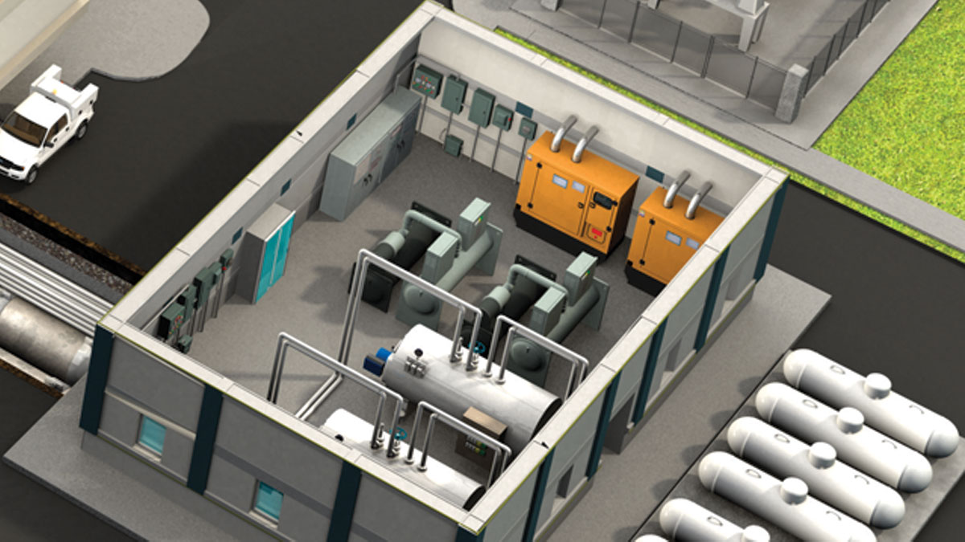
Liquid Ingress Protection

Slide 21




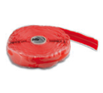

Liquid Ingress Protection
Electrical Solutions for the Commercial & Institutional Facilities
^{Thomas & Betts brands}
^{for liquid ingress}
^{protection}
The financial impact of allowing liquid to
migrate into electrical systems can be significant — whether the result of downtime
or having to replace damaged components.
Carlon®
Elastimold®
Emergi-Lite®
Hazlux®
Homac®
Iberville®
Kopex-ExTM
Lumacell®
OcalTM
Lumacell®
PMA®
Ready-Lite®
Red•Dot®
Reznor®
Russellstoll®
Shrink-KonTM
Sta-Kon®
T&B® Fittings
Red•Dot®
Code KeeperTM Weatherproof
While-In-Use Covers
PMA®
Flexible Nylon Conduit Systems
Homac®
Flood-SealTM Multi-Port Connectors
Shrink-KonTM
Wire and Connector Insulation Products
Electrical Division
Notes:
21

Slide 22
Thank You!!!

